Slide 1
Group Project Team 3 – Option 3
Team Members:
Chen Dekun
Chen Qingyuan
Li Ming
120090336
120090747
120090675
Nasr Alae-eddine
Zhang Jiayu
Zhang Haomin
119010531
120010027
118010408

Slide 2
项目分析幻灯片 2
Content
Abstract
Environment
Team 3
Strategy
Implementation
Live Test
Conclusion

Slide 3
项目分析幻灯片 11
Abstract
DB61B
A miniature Relational Database Management System (DBMS)
What The Project Is
What The Final Goal Is
Basic functions:
load, insert, select, …

Slide 4
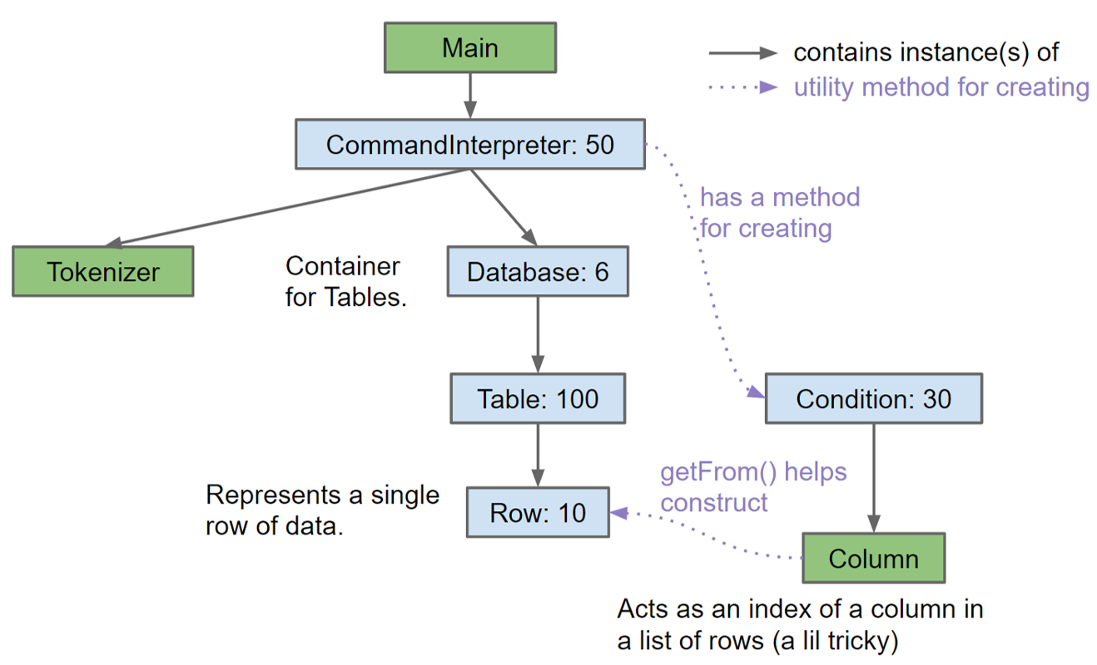
项目分析幻灯片 11
Strategy
Java
Object-Oriented

Slide 5
项目分析幻灯片 11
Strategy
Our Checklist
Complete the printing of prompts
Ran first Test
Implement the Row class (except for the constructor)
Implement the parts of the Table class: Create a new Table, Add a Row to it, and Print an entire Table.
Implement the Database class.
Implement the Condition class.
Implement insert and load.
Implement the kind of select that takes a single table and has no conditions.
Implement the Row constructor.
Get single-table select with conditions to work.
Work on the two-table variety of select.

Slide 6
项目分析幻灯片 6
Live Test
Test Load & Store
Test xxx
Test Select
Test xxx
Test Print
Test xxx

Slide 7
项目分析幻灯片 3
Environment
Program Language
Git Management
Dependency
Testing
Java for functions
Python for running tests
…
…
…
…
Maven details..
…
…
…
…

Slide 8
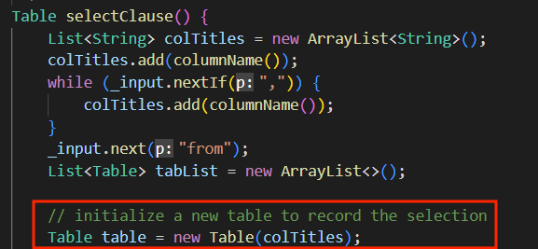
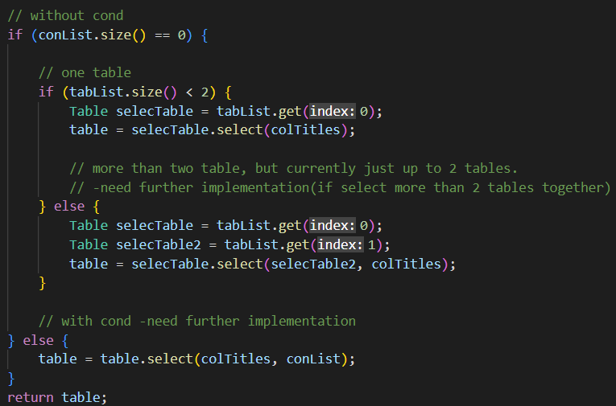
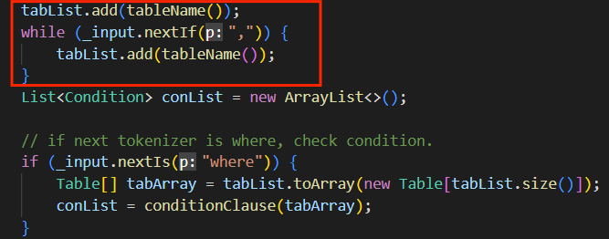
项目分析幻灯片 11
Implementation
Selection Clause
Step 1: Create a new table using selected columns
Step 3: Execute selection
Step 2: Create Arraylist to store selected tables

Slide 9
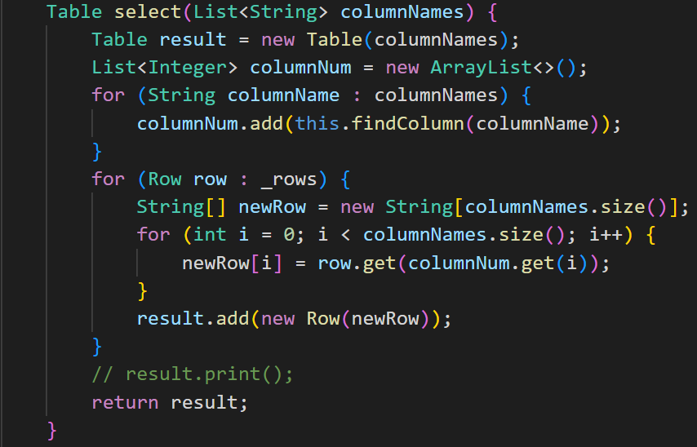
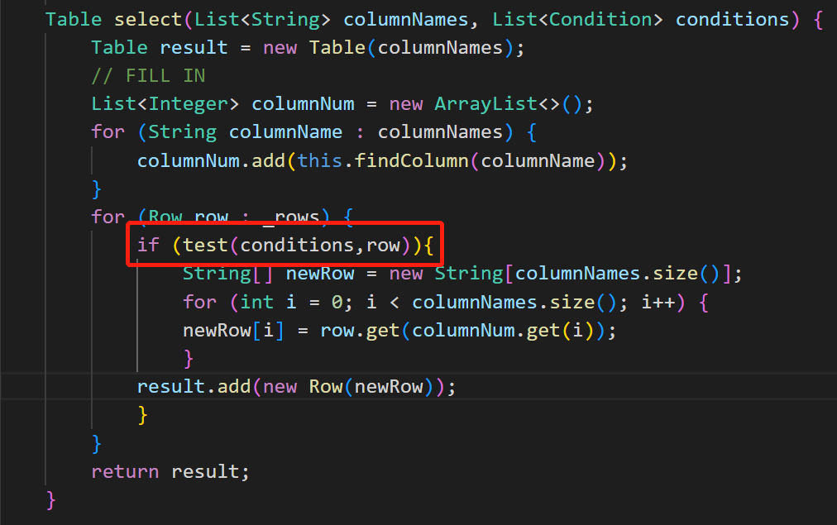
Implementation
Selection with conditions

Slide 10
项目分析幻灯片 11
Conclusion
Basic DBMS
Maven Management
Successful on small databases
Implement
Tests
Step-by-step Checklist
Need more functions or more efficiency

Slide 11
Thanks

